Slide 1

Task-Aware Object Identification using
FPGA-Accelerated YOLO and Semantic Ranking on PYNQ-Z2
Project-I (2026) • Review-I
Team Members
Shubh Gupta — 23BLC1322
Aarav Sharma — 23BLC1300
Ankush Kumar Jaiswal — 23BLC1179
Guide's Signature with Date
Signature: __________________
Date: ______________________
Guide
Prof. Jean Jenifer Nesam J
B.Tech — SENSE, VIT Chennai
Please obtain the guide's signature/date and scan this slide before submission.
1

Slide 2
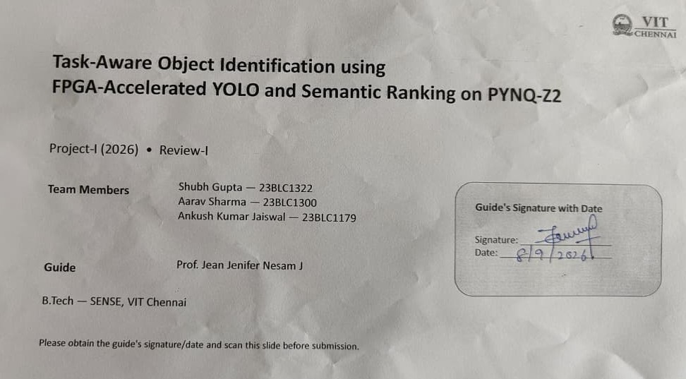

Slide 3
Review focus
Current project direction
Problem clarity • literature survey • proposed solution • methodology • work completed so far
FPGA-accelerated YOLO performs object detection on PYNQ-Z2 board on real time image with task-aware semantic ranking.
Target outcome
Implementation status
Real-time edge inference (~30 FPS) within a power envelope below 15 W,.
Architecture/design phase. Physical build and hardware bring-up are planned for the implementation phase.
Presentation basis: current project deck + VIT Review-I template.
2

Slide 4
Problem Statement & Background
Problem statement
Example
Conventional object detectors identify and classify objects, but they do not determine which detected object best satisfies a user-defined task.
For the task “sit comfortably”, the system should rank a chair above visually detected alternatives such as a TV.
Existing approach
Research gap
Current pipeline: image → Tiny YOLOv2 on PYNQ board → detected objects → classifier using model 2 → final prediction.
Detection is separated from task-oriented semantic reasoning. The proposed work addresses this using a heterogeneous FPGA + processor architecture.
3

Slide 5
Literature Survey
No. | Author(s) & Year | Title / Source | Method / Approach | Finding / Relevance
1 | H. Li et al., 2024 | FPGA-Based YOLOv5 Accelerator for Real-Time Industrial Vision Applications | FPGA YOLO acceleration | Supports hardware-accelerated YOLO for real-time vision.
2 | Y. Zhang et al. | FPGA-Based YOLOv6 Accelerator for High-Throughput and Energy-Efficient Object Detection | FPGA accelerator | Highlights throughput and energy efficiency.
3 | R. Patel et al. | Optimizing Resource Utilization and Power Efficiency in FPGA-Accelerated YOLOv8 Using Vivado HLS | Vivado HLS optimization | Relevant to LUT/DSP/resource-aware implementation.
4 | Xilinx Inc. | Designing High-Performance Video Systems in 7 Series FPGAs with AXI Interconnect (XAPP741) | AXI/video data movement | Relevant to camera, AXI and video pipelines.
5 | AMD/Xilinx | PYNQ-Z2 Board Reference Manual and Datasheet | Target hardware | Defines Zynq XC7Z020 resources and interfaces.
6 | C-DAC | VEGA RISC-V Processor Architecture Documentation | RISC-V soft-core | Basis for semantic reasoning processor.
7 | Z. Ziyuan | Building Vision-Language Retrieval Systems with CLIP | CLIP embeddings | Supports text/image semantic similarity.
8 | M. Rossi et al. | Enhancing Multi-Object Tracking with CLIP: A Comparative Study | CLIP for vision tasks | Supports CLIP-based semantic ranking context.
4

Slide 6
Proposed Solution & Methodology
Proposed heterogeneous architecture
1. Image input
2. FPGA perception
3. Semantic reasoning
4. Output
Camera / image frame
Tiny YOLOv2
Object d detection head + NMS on pynq-z2 board
CLIP text embedding + cosine similarity
Ranked objects + bounding-box overlay
HDMI visualization
Methodology
DSP48E1 Convolution Mapping: Map 2D convolution MAC operations onto the 220 DSP48E1 slices of the PYNQ-Z2 Zynq-7000 (XC7Z020) PL fabric.
BRAM Line Buffering: Use 560 KB on-chip BRAM (140 X 36Kb blocks) for sliding-window feature-map buffering, eliminating off-chip DRAM bottlenecks.
AXI VDMA Data Streaming: Stream video frames between 512 MB DDR3 memory and the PL accelerator overlay via high-throughput AXI4-Stream & VDMA.
Embedded Task Ranking (Model 2): Execute semantic task parsing and CLIP vector cosine similarity on the dual-core ARM Cortex-A9 CPU (with NEON acceleration) / VEGA RISC-V core via pynq.Overlay.
PYNQ Co-Design Scope: Architectural mapping, INT8 model conversion, AXI DMA zero-copy memory allocation (pynq.allocate), and bitstream deployment.
5

Slide 7
Target Hardware
Board: PYNQ-Z2, Xilinx Zynq XC7Z020-1CLG400C SoC development board
On-chip resources used: DSP48 slices, LUT logic, BRAM, and DDR3 external memory
I/O: camera/image input, AXI interconnect and VDMA for video data movement, HDMI display output
Architecture design phase — physical build and bring-up planned for the implementation phase

Slide 8
Design Specifications
Target board: PYNQ-Z2, Xilinx Zynq XC7Z020-1CLG400C SoC (FPGA + ARM Cortex-A9)
YOLO-to-FPGA mapping: convolution → DSP48 slices; activation (Leaky ReLU) → LUT logic; bias addition → LUT/DSP; feature maps → BRAM; model weights → DDR3
Memory hierarchy: BRAM for feature-map/line buffers, DDR3 for weights and full frames, flash for CLIP embeddings and firmware
VEGA ET1031 RISC-V core: RV32IM ISA, 3-stage in-order pipeline, ~100 MHz, hardware multiplier, implemented as a soft core in the FPGA fabric
Target performance: ~30 FPS real-time inference, under 15 W power envelope

Slide 9
Current Detection Pipeline
Image → Tiny YOLOv2 (PL) → Detected Objects → Classifier (PS + DDR3 RAM) → Final Prediction
Input Image
FPGA Fabric (PL)
PS + On-board DDR3 RAM
Final Prediction
Sample camera frame
Zynq XC7Z020
ARM Cortex-A9 (PS)
DDR3 RAM
Bounding box +
class label
overlay
Tiny YOLOv2
(Object Detection)
Classifier
(Object Classification)
Class: <object>
Confidence: 0.XX
Bounding boxes + confidence scores
Classifier runs on PS using DDR3 RAM
FPGA Fabric (PL)
PS + DDR3 RAM
Output
Tiny YOLOv2 runs on the Zynq PL (FPGA fabric) for high-speed object detection.
Classifier runs on the PS (ARM Cortex-A9) using on-board DDR3 RAM.
Final predicted class with confidence score overlaid on the frame.

Slide 10
Work Completed (50%), Timeline & Tools
Work completed so far
Status / timeline
• Problem definition and task-aware vision objective established.
• System architecture defined: FPGA YOLO + ARM Cortex-A9 semantic analyzer.
• Current Tiny YOLOv2 detection pipeline documented.
• PYNQ-Z2 / Zynq XC7Z020 resource mapping identified.
• Model conversion flow defined: YOLO →quantized modle->PYNQ board-> hardware.
• CLIP cosine-similarity ranking formulation defined.
• Memory hierarchy and AXI/VDMA data movement identified.
Review-I
Problem + literature + proposed architecture
Current design documentation + 50% work (software)
Review-II
Implementation / synthesis and hardware integration
→ 75% work
Review-III
Bring-up, benchmarking and final evaluation
100%→ Demo
6

Slide 11
Analysis
Convolution engine: MAC = Input × Weight + Partial Sum, computed via BRAM feature fetch → DSP multiply-accumulate array → activation unit → output feature map
Three-level pipelining: instruction-level (read/multiply/accumulate/activate), layer-level (conv/pool/detect run concurrently), and frame-level (buffer rotation across frames) for continuous real-time inference
CLIP-based semantic ranking: Similarity = (Image Vector · Text Vector) / (|Image Vector| × |Text Vector|); the VEGA core computes this cosine similarity to rank candidate objects against the task query

Slide 12
Model Conversion & Deployment Workflow
Python YOLO Model
Trained in PyTorch / TensorFlow
ONNX Export
Framework-independent graph: layers, weights, tensor ops
HLS Conversion
ONNX → C/C++ → Vivado HLS synthesis
RTL Hardware Generation
Synthesized into FPGA logic blocks (PYNQ-Z2)

Slide 13
Results / Current Design Analysis
Compute mapping
Pipelining concept
MAC = Input × Weight + Partial Sum. Feature data is fetched from BRAM and processed through DSP multiply-accumulate logic followed by activation.
Three levels are defined: instruction-level (read/multiply/accumulate/activate), layer-level (conv/pool/detect overlap), and frame-level buffering.
Memory hierarchy
Target specifications
BRAM: feature maps / line buffers
DDR3: weights / full frames
Flash: CLIP embeddings / firmware
PYNQ-Z2 / XC7Z020 • ARM Cortex-A9• ~100 MHz soft-core target • ~30 FPS inference • <15 W target envelope
7

Slide 14


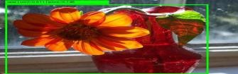


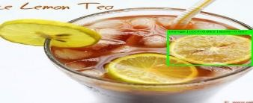
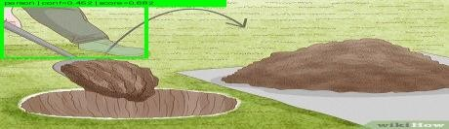
Results
S.No. | Input Text | Output Object Confidence and Score | Image Output
1 | the person stepped on something | Person,0.925,0.795
2 | i want to sit in a relaxed manner | Toilet,0.8750.763
3 | something which contains smelling good thing | Vase, 0.911,0.747
4 | item wbhich provide carbohydrate is taking out of fire | Potato,0.422,0.643
5 | someone is watering the plant | Person,0.793,0.742
6 | something is to be taken away from tea cup | Orange,0.651,0.696
7 | someone digs hole | Person,0.451,0.681
7

Slide 15
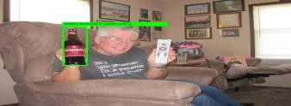
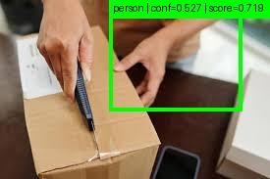
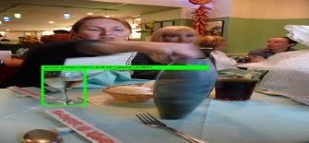
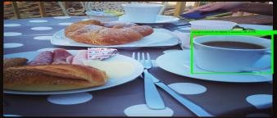
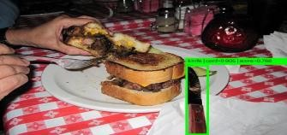
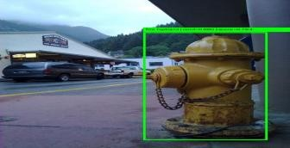
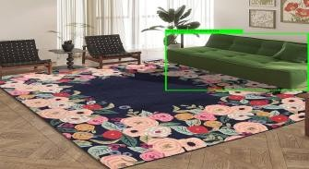
Results
8 | bear bottle open | Bottle,0.877,0.813
9 | someone is opening parcel | Person,0.526,0.718
10 | object used to serve wine | Wine Glass,0.914,0.807
11 | substance which contain sugar | Cup,0.869,0.774
12 | item to smear button on bread | Knife,0.905,0.765
13 | object that is use to control fire | Fire handpump,0.879,0.763
14 | something is being placed on pound carpet | Couch,0.932,0.753
7

Slide 16
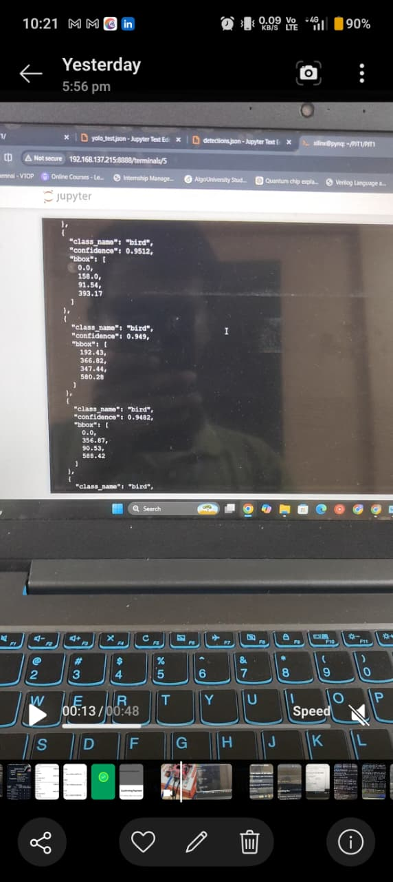
Results(Hardware)
7

Slide 17
Results (contd.) — Deployment Workflow & Target Hardware
Python YOLO Model
ONNX Export
HLS Conversion
PyTorch / TensorFlow
Framework-independent graph
ONNX → C/C++ → PYNQ Board
Target hardware & interfaces
• PYNQ-Z2: Xilinx Zynq XC7Z020-1CLG400C SoC (FPGA + ARM Cortex-A9).
• On-chip resources: LUT logic, DSP48 slices and BRAM; external DDR3 memory.
• VEGA ET1031 RISC-V soft core instantiated in the FPGA fabric for semantic ranking.
• Camera/image input → AXI interconnect + VDMA → processing → HDMI display.
8
Notes:
Add your results here — graphs, tables, screenshots or outputs.

Slide 18
Expected Outcomes & Next Steps
Expected outcome
Why the split matters
A task-aware edge vision system that combines fast FPGA-based YOLO perception with flexible semantic ranking.
Compute-heavy perception remains in programmable logic, while task reasoning remains software-defined on the RISC-V processor.
Next implementation steps
• Synthesize and validate the YOLO hardware pipeline on PYNQ-Z2.
• Integrate AXI/VDMA and DDR3 data movement.
• Instantiate and validate the VEGA RISC-V semantic-ranking core.
• Integrate CLIP embeddings and cosine-similarity ranking.
• Benchmark FPS, latency, power and FPGA resource utilization.
9
Notes:
Add your results here — graphs, tables, screenshots or outputs.

Slide 19
Potential Applications of the Proposed System
The proposed system combines real-time object detection with task-aware semantic ranking, so it can detect multiple objects and then select the object most relevant to a natural-language task.
Assistive robotics
Smart surveillance
“Find something to sit on” → rank chair/sofa above irrelevant objects. Useful for assistive and mobile robots.
Operator-defined tasks can prioritize relevant objects/events instead of treating every detection equally.
Autonomous vehicles / ADAS
Industrial inspection
Edge detection can identify vehicles, pedestrians and hazards; semantic ranking can prioritize the object relevant to the current task.
FPGA-accelerated detection supports low-latency inspection; semantic ranking can focus on the component or defect requested by the operator.
Smart-home / IoT vision
Road / infrastructure monitoring
Low-power local vision can identify household objects and select the object matching a natural-language request.
Edge detection can support pothole and road-hazard monitoring; task queries can prioritize specific infrastructure hazards.

Slide 20
Research Literature — Papers 1–4
[1]
J. Redmon, S. Divvala, R. Girshick, and A. Farhadi, “You Only Look Once: Unified, Real-Time Object Detection,” in Proc. IEEE Conf. Computer Vision and Pattern Recognition (CVPR), 2016, pp. 779–788, doi: 10.1109/CVPR.2016.91.
Paper link: https://doi.org/10.1109/CVPR.2016.91
[2]
H. Li et al., “An FPGA-Based YOLOv5 Accelerator for Real-Time Industrial Vision Applications,” IEEE Access, 2024.
Paper link: https://pmc.ncbi.nlm.nih.gov/articles/PMC11434529/
[3]
E. Emmanuel, F. Lacy, and Y. Ismail, “Optimizing Resource Utilization and Power Efficiency in FPGA-Accelerated YOLOv8 Object Detection Using Vivado High-Level Synthesis (HLS) Tool,” in Proc. 2nd Int. Conf. Artificial Intelligence, Blockchain, and Internet of Things (AIBThings), 2024, pp. 1–4, doi: 10.1109/AIBThings.2024.10863546.
Paper link: https://ieeexplore.ieee.org/document/10863546
[4]
X. Sha, M. Yanagisawa, and Y. Shi, “An FPGA-Based YOLOv6 Accelerator for High-Throughput and Energy-Efficient Object Detection,” IEICE Trans. Fundamentals, vol. E108-A, no. 3, pp. 473–481, 2025, doi: 10.1587/transfun.2024VLP0009.
Paper link: https://doi.org/10.1587/transfun.2024VLP0009

Slide 21
Research Literature — Papers 5–8
[5]
Z. Zhang, M. A. Parvez Mahmud, and A. Z. Kouzani, “Resource-constrained FPGA implementation of YOLOv2,” Neural Computing and Applications, vol. 34, no. 19, pp. 16989–17006, 2022, doi: 10.1007/s00521-022-07351-w.
Paper link: https://doi.org/10.1007/s00521-022-07351-w
[6]
Z. Zhang and A. Z. Kouzani, “Resource-constrained FPGA/DNN co-design,” Neural Computing and Applications, vol. 33, no. 21, pp. 14741–14751, 2021, doi: 10.1007/s00521-021-06113-4.
Paper link: https://doi.org/10.1007/s00521-021-06113-4
[7]
W. Qian, Z. Zhu, C. Zhu, W. Luo, and Y. Zhu, “Efficient deployment of Single Shot Multibox Detector network on FPGAs,” VLSI Integration, vol. 99, Art. no. 102255, 2024, doi: 10.1016/j.vlsi.2024.102255.
Paper link: https://doi.org/10.1016/j.vlsi.2024.102255
[8]
A. Radford et al., “Learning Transferable Visual Models From Natural Language Supervision,” in Proc. 38th Int. Conf. Machine Learning (ICML), PMLR, vol. 139, pp. 8748–8763, 2021.
Paper link: https://proceedings.mlr.press/v139/radford21a.html

Slide 22
Thank You
Task-Aware Object Identification using FPGA-Accelerated YOLO and Semantic Ranking on PYNQ-Z2
Shubh Gupta • Aarav Sharma • Ankush Kumar Jaiswal
11

